Slide 1
React
Frandy Jaya | Front End Developer

Slide 2
About Me
Name : Frandy Jaya
Position : Software Development Engineer
Role : Front End Developer

Slide 3
Outline
What is React?
Why React?
JSX

Slide 4


What is React?
React is a UI library developed at Facebook to facilitate the creation of interactive, stateful & reusable UI components.

Slide 5
Why React?
Complicated DOM
State Management
Component Reusability

Slide 6
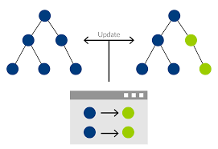
Why React?
Virtual DOM
<div>
<div>
<span>Om</span>
<span>Telolet</span>
</div>
<div>
<span>Om</span>
</div>
</div>

Slide 7
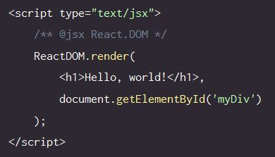
JSX
Basic React

Slide 8

Demo

Slide 9
Reference
Scotch.io – Learning React Getting Started and Concepts
https://scotch.io/tutorials/learning-react-getting-started-and-concepts
LearnCode.academy – React JS Tutorial
https://www.youtube.com/watch?v=MhkGQAoc7bc&list=PLoYCgNOIyGABj2GQSlDRjgvXtqfDxKm5b
Slide :
http://www.slideshare.net/jayahana9/react-introduction-bliblicom

Slide 10
Contact Me
Email : jayallways@gmail.com

